Slide 1
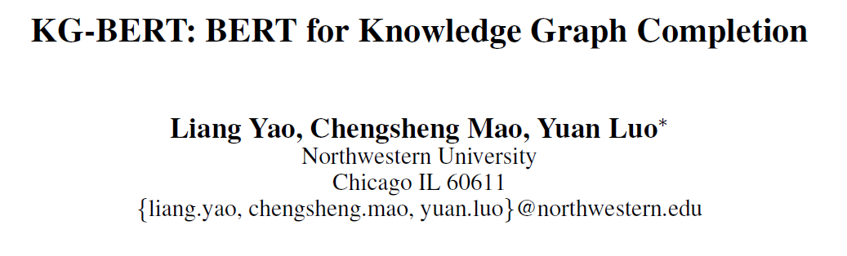
Haobo Xu
2022/9/7

Slide 2
Outlines
Background
Motivation
Method
Finetune a)
Finetune b)
Experiment
Discussion
Yao, L., Mao, C., & Luo, Y. (2019). KG-BERT: BERT for knowledge graph completion. arXiv preprint arXiv:1909.03193.

Slide 3
Background
Knowledge graph embedding
Only structure information: TransE, DistMult…
Including external information: entity types, logical rules…
Same words but different meaning cases
Pre-trained language representation models
feature-based: ELMo…
fine tuning based: GPT, BERT…

Slide 4
Motivation
Treat entities, relations and triples as textual sequences and fine-tune BERT model
Why Pre-training?
Traditional methods
only use structure information, but knowledge graphs are sparse
Why Language Models?
Traditional methods
ignore contextual information
not fully utilize syntactic and semantic information in large-scale text data
Notes:
先总结

Slide 5
Contributions
The first study to model triples’ plausibility with a pretrained contextual language model.
Achieve state-of-the-art results in triple classification, relation prediction and link prediction tasks.

Slide 6
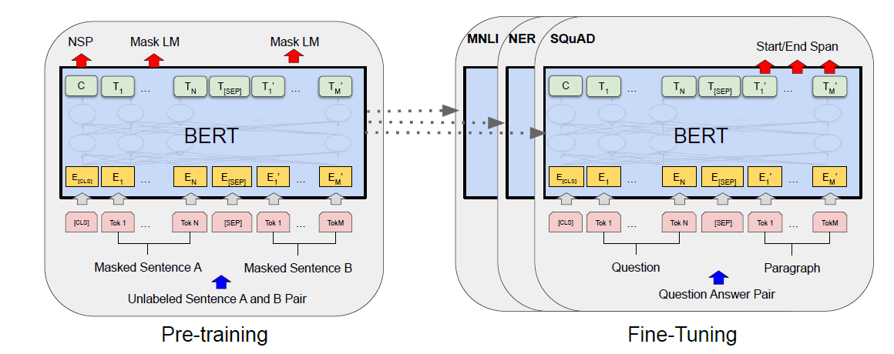
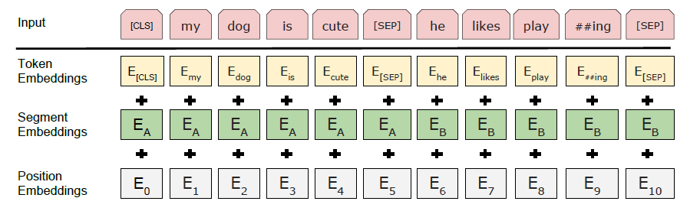
Method
BERT
Pre-training
Separate words into
tokens(WordPiece)
Learn token
embeddings
Fine-tuning
Learn params
for downstream classification tasks
Notes:
Input / output 直观一点
可以加一页讲传统BERT讲讲背景
哪些是要学的，pretrain学了哪些，讲一讲
语料库集合之间的关系可以描述一下（有可能约束，比如OGB，在大图以及BERT的效率）
可以画一个流程图讲清楚流程

Slide 7
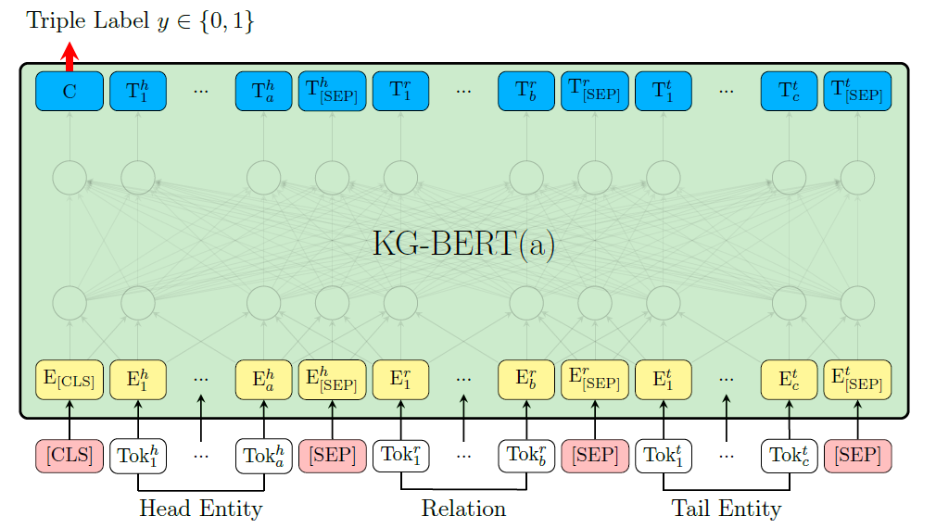
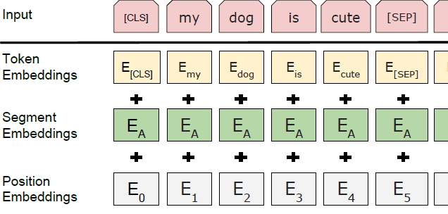
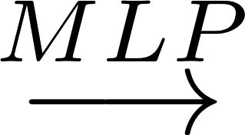
Method
Fine-tuning a)
Triple Classification / Link prediction
Input
Output: [CLS] token binary classification
Notes:
Input / output 直观一点
可以加一页讲传统BERT讲讲背景
哪些是要学的，pretrain学了哪些，讲一讲
语料库集合之间的关系可以描述一下（有可能约束，比如OGB，在大图以及BERT的效率）
可以画一个流程图讲清楚流程

Slide 8
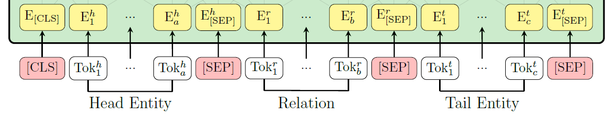

Method
Fine-tuning a)
Token Embedding:
Find a sentence containing head/relation/tail and separate the sentence into Tok₁, … ,Tok_{n}
Example：“Apple Inc. is an American multinational technology company headquartered in Cupertino, California.” or “Apple Inc.”.
Segment Embedding:
head & tail for E_{A} and relation for E_{B}
Scoring function:
C is hidden state of [CLS]
W is classification layer
Loss: cross-entropy

Slide 9
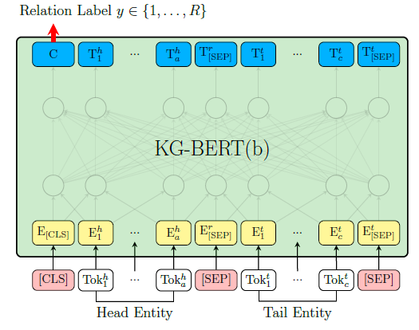

Method
Fine-tuning b)
relation prediction (h, ?, t)
Scoring function:
W is classification layer
Loss function: cross-entropy

Slide 10
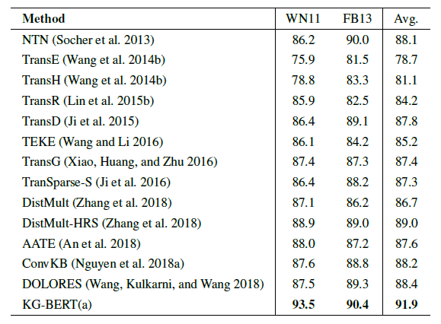
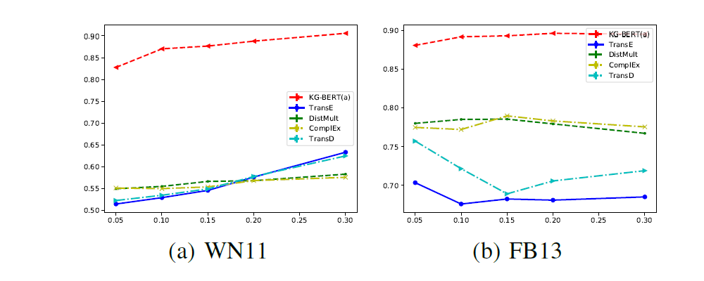
Experiment
Settings: BERT-Base (12 layers, 12 multi-head, 768 hidden size)
3 tuned number of epochs for triple classification, 5 for link (entity) prediction and 20 for relation prediction.
BERT-Base outperforms BERT-Large (larger model)
Triple classification (h, r, t)->{True, False}
TEKE and AATE outperform their base models
like TransE and TransH
→ external text data is necessary
KG-BERT performance on WN11 is better than FB13
→ WN is a linguistic knowledge graph closer to linguistic pattern
KG-BERT perform well by:
Input is sequence containing relation word
Contextual embedding
Triple classification is similar to next sentence prediction pre-train task
Notes:
Query2box logical rule 死逻辑
BERT NLP rule 上下文
可以看看已有工作

Slide 11
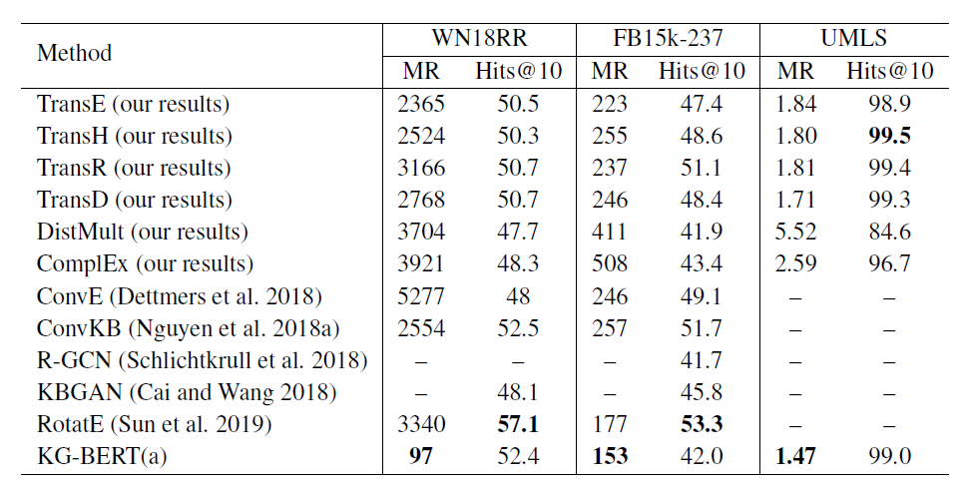
Experiment
Link Prediction (h, r, ?) / (?, r, t)
MR is best but Hits@10 is not that good
BERT can avoid very high ranks,
but the KG structure information
is not explicitly modeled.
Good recall but poor accuracy
Notes:
Acc和recall，和歧义现象等可能有关
BERT可能更模糊，预测大致方向
Enumerate each “?” in entity set E and then
implement triple classification for each case

Slide 12
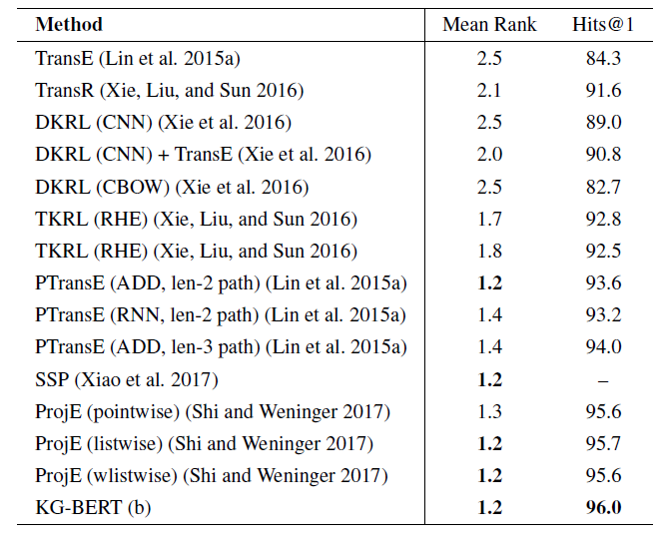
Experiment
Relation Prediction (h, ?, t)

Slide 13
Discussion
Data leakage problem
Technical terms never appear in pre-training may not work (e.g. OGB)
Including structure information of KG may be better
(combine KGE and Language Representation Embeddings)
K-BERT (Liu et al., AAAI 2020)
KEPLER (Wang et al., TACL 2020)
Notes:
没有利用显示上下文，利用两边上下文

